Slide 1
Unlocking the Power of Genedata Biologics: Exploring How We Use The Genedata Biologics Within BMD
Yinfeng Zhang, Diana Sapashnik
September 14th, 2023

Slide 2
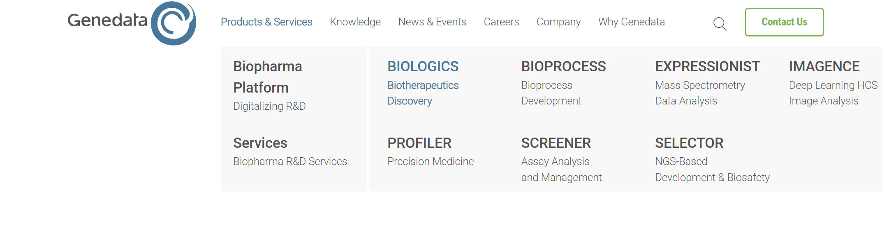

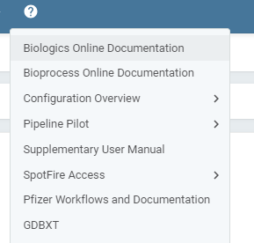
Genedata Biologics

Slide 3
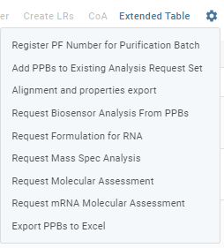
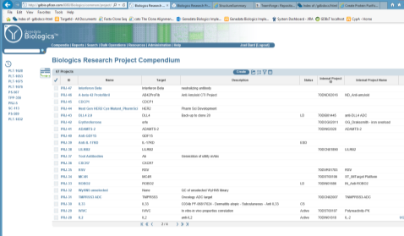
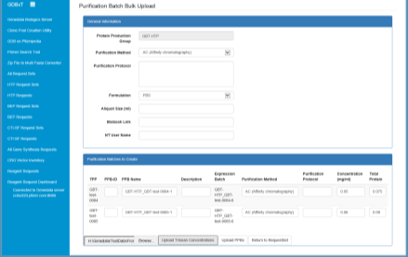
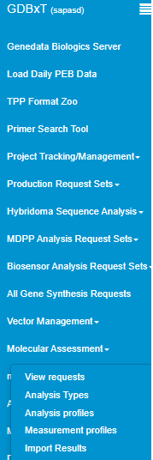

What Is GDBxT?
Application Layer
Genedata External Tool Adapter
Genedata Biologics
In House GDBXT
Database Layer
GDB
Companion
Screens
Sequences
Batches
Results
Automation
Requests
Reports
Ordering
Tools
Automation
GDBxT Navigation Panel
Questions or issues? Email DL-BMD_BIOINFORMATICS

Slide 4
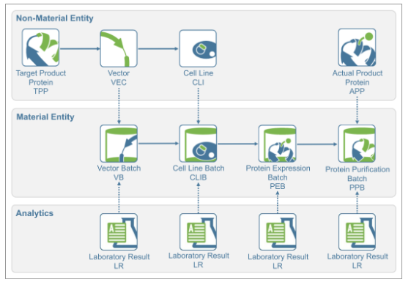
Genedata Core Concepts
Non-Material Entity – The idea of what we're going to make
Sequences
Type of biotherapeutic
Material Entity – The thing we actually made
Which plasmids were used?
Concentration of plasmid batch; when was it made and by who?
Expression conditions?
Purification conditions?
Analytics – Results of assay run

Slide 5
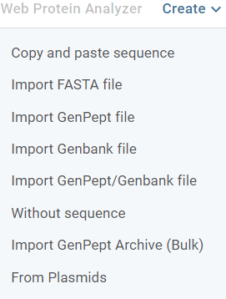
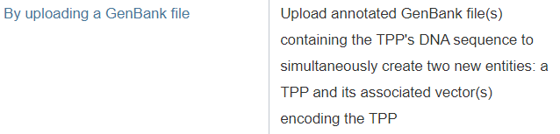

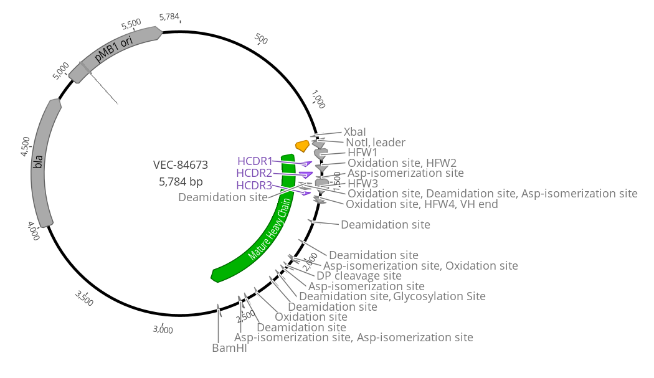
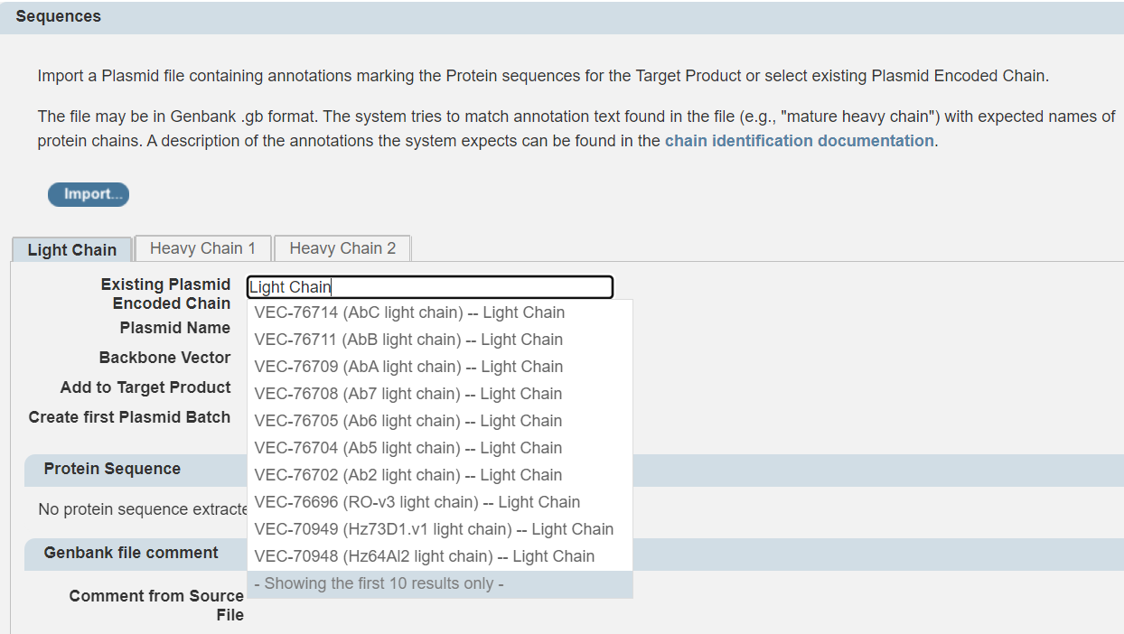
TPPs* In Genedata – Target Product
TPP is a biotherapeutic entity – mAb, bispecific, mRNA, AAV, etc.
TPPs must be associated with one or more Project
TPPs can be created by providing sequences either through upload, linking to existing plasmids (VEC) in the system, or without a sequence (which can be uploaded later)
.gb
*Genedata legacy note : TPP originally stood for Target Protein Product. A lot of Protein nomenclature remains from pre-2020 when Genedata was used exclusively for antibodies and other proteins.

Slide 6
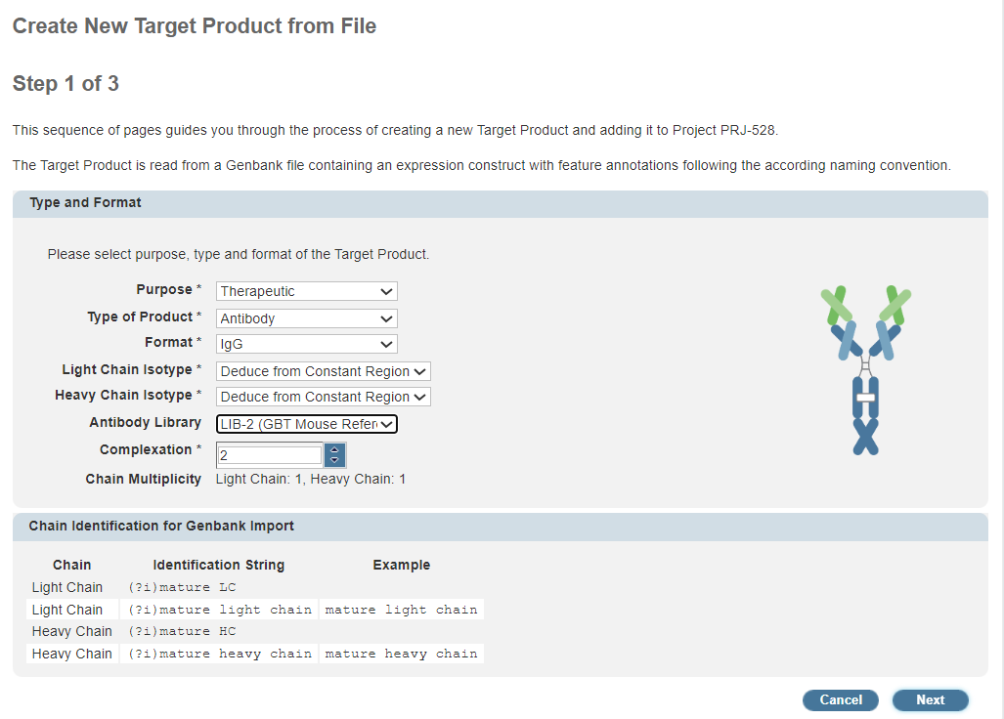
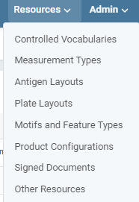
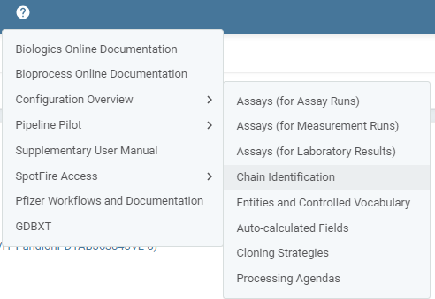
TPP - Registering Different Types of Biotherapeutics
All available formats listed in Product Configurations, Formats table
Need new format? Email DL-BMD_BIOINFORMATICS with fasta/Genbank example and image for Genedata
Formats define chains – example HC and LC for IgG
Chain annotations are interpreted by Genedata Biologics – example : extract gene of interest for mRNA by finding mature_mrna annotation
For protein chains annotation covers translated sequence; for mRNA chain annotation covers end of T7 promoter to polyA tail
When creating a new TPP need to select the right format
Antibody library important for Genedata automatic annotations of CDRs and FWRs
Complexation automatically set by format; monomer, dimer, n-mer
Chain multiplicity is number of copies of chain / complexation

Slide 7
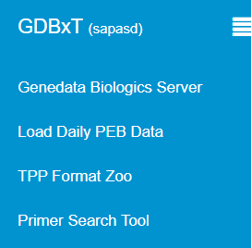
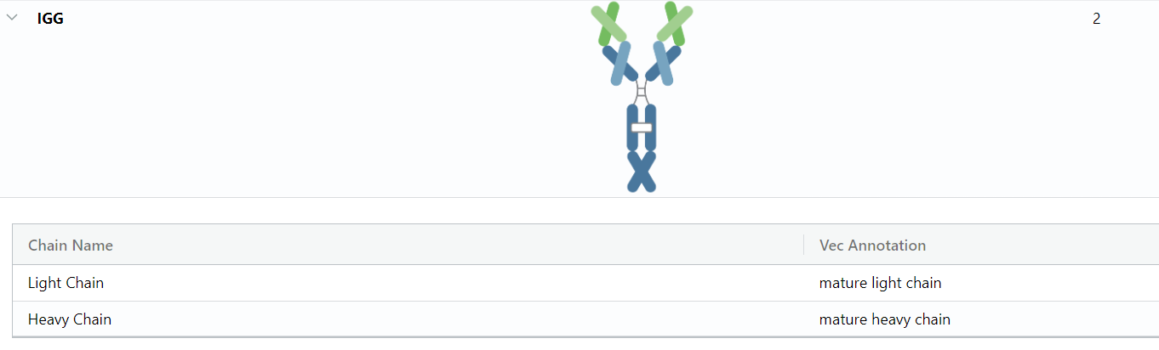
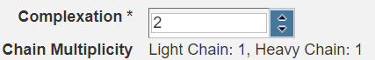
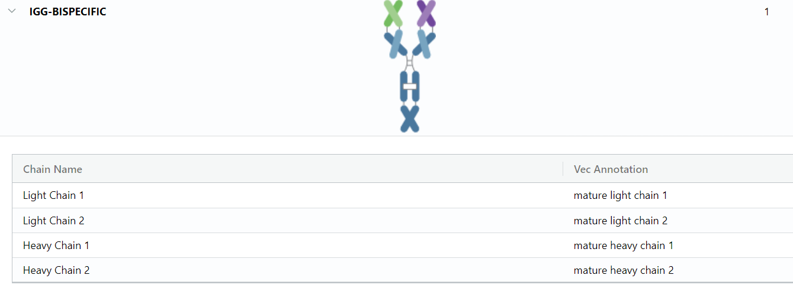
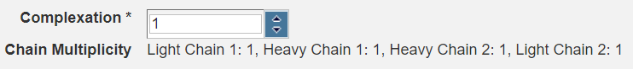
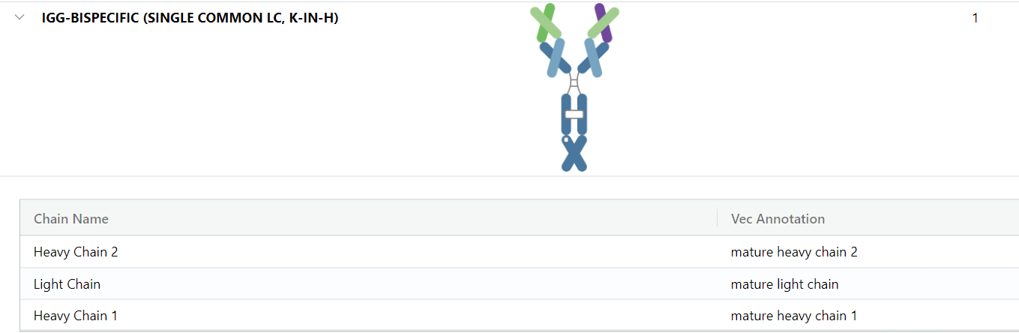
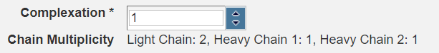
TPP Format Zoo In GDBxT
Complexation
Complexation
Complexation

Slide 8

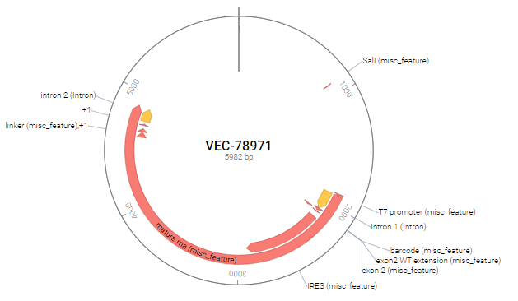
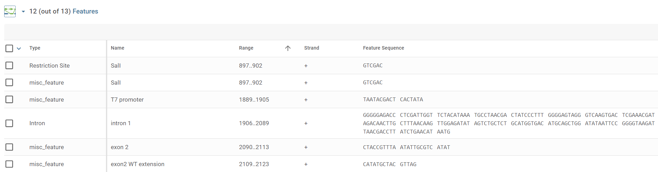
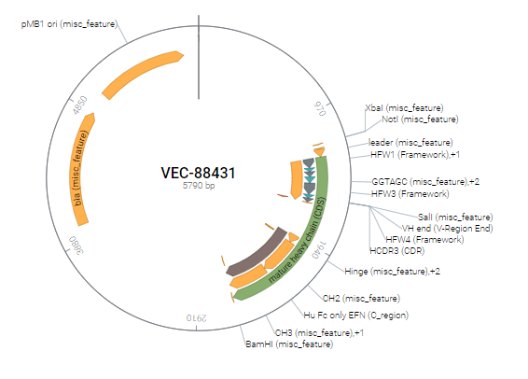
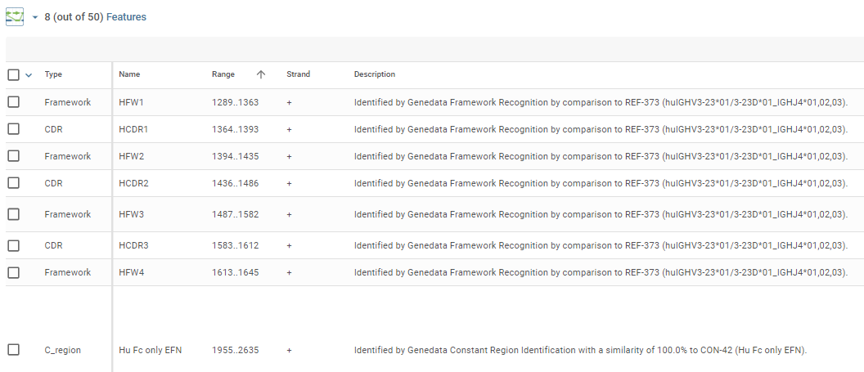
Vector (Plasmid) Registration
Plasmids are linked to a Target Product
Can be reused by linking to other Target Products
Chain annotations are interpreted by Genedata Biologics – example : extract gene of interest for mRNA by finding mature_mrna annotation
Genbank file annotations displayed as plasmid features, original and Genedata generated Genbank files can be downloaded
For protein chains annotation covers translated sequence; for mRNA chain annotation covers end of T7 promoter to polyA tail

Slide 9

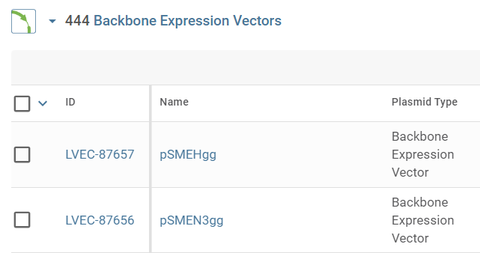
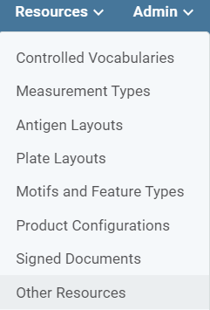
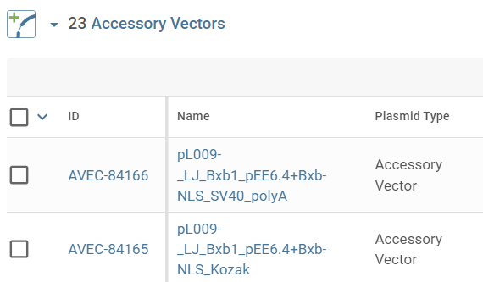
Vectors Cont.
New version of Genedata includes sequence alignment for Vectors and TPPs
Compendia Plasmids or Target Product
Other types of VEC
LVEC Backbone Vectors
AVEC Accessory Vectors

Slide 10
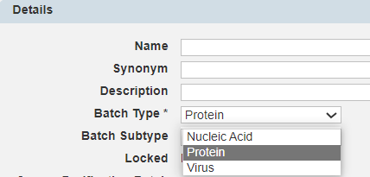
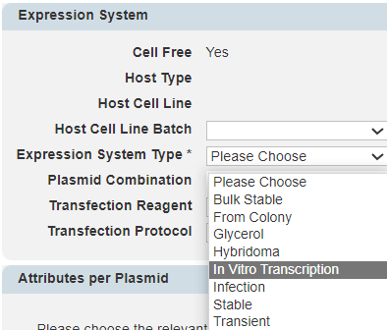
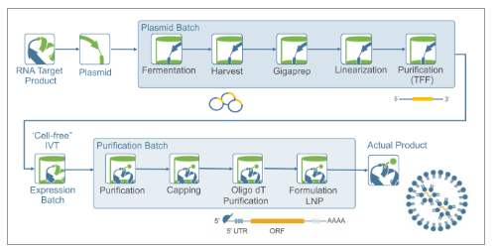
Expression Batches (PEB)
PEB is a combination of a Vector Batch (VB) and a Host Cell Line (Cell Free option for mRNA)
Batch Type can be set to Protein, Nucleic Acid for mRNA, or Virus for legacy AAV; Batch Subtype is optional
mRNA : What is the expression batch?
TPP
VEC
VB
PPB (DS)
PPB (DP)
PEB

Slide 11

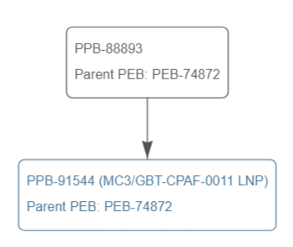
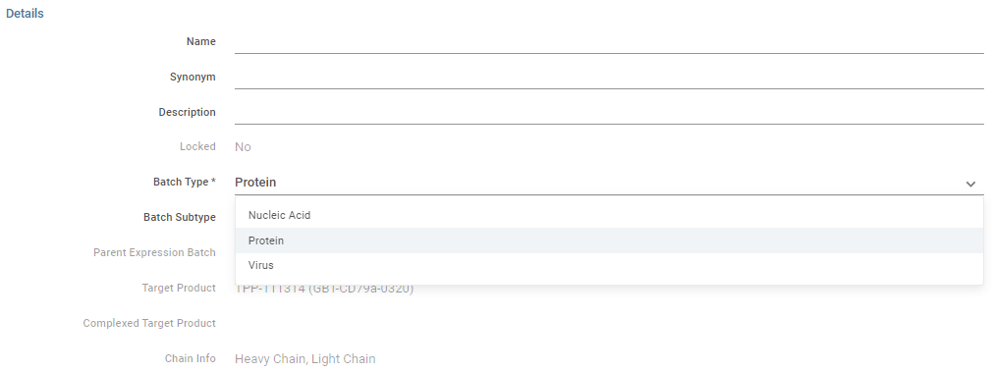
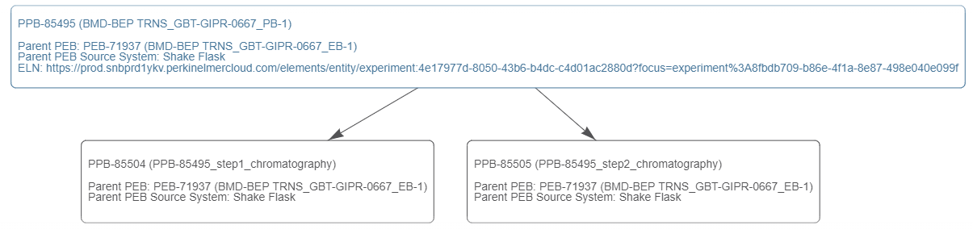
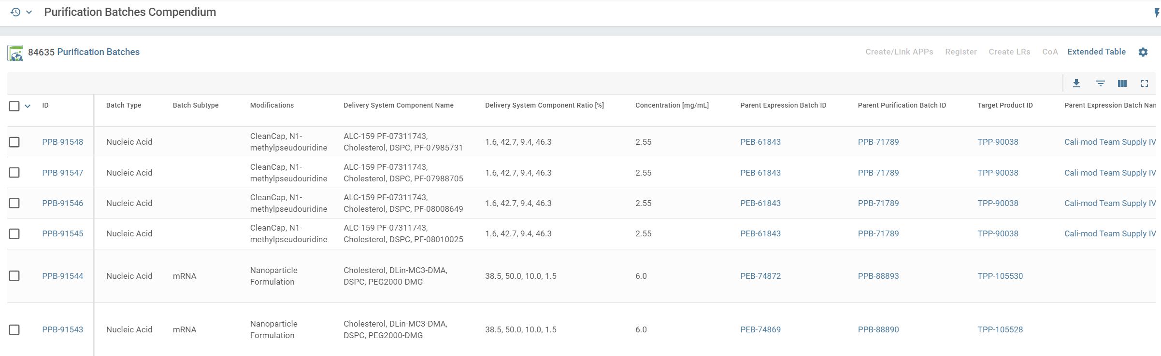
Purification Batches - PPBs
Batch Type can be set to Protein, Nucleic Acid for mRNA, or Virus for legacy AAV; Batch Subtype is optional
Multiple PPBs can be related to a single TPP

Slide 12
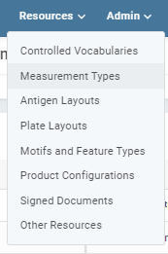
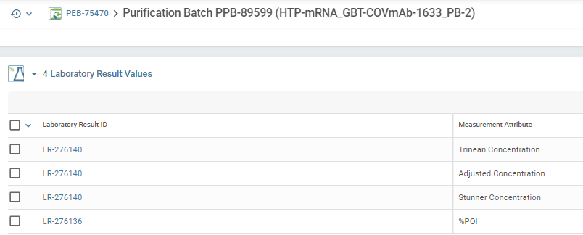
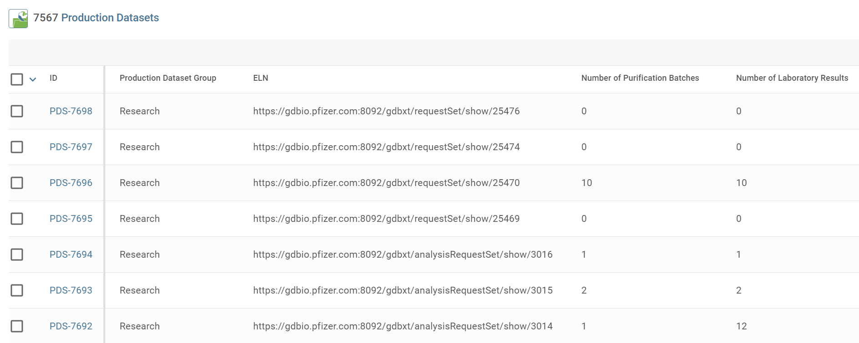
Analyzing Batches - Laboratory Result Upload
At each step of production, assays are run to confirm yields and batch quality
Assay results translate to Laboratory Results, which can be attached to any Genedata entity batch
Plasmid Batch QC Expression Batch QC Purification Batch QC

Slide 13
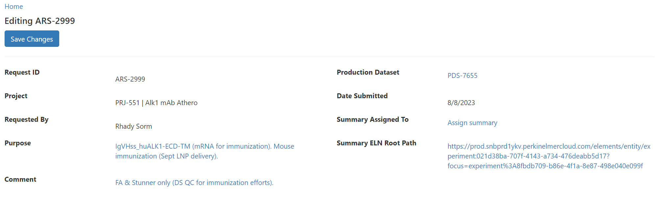
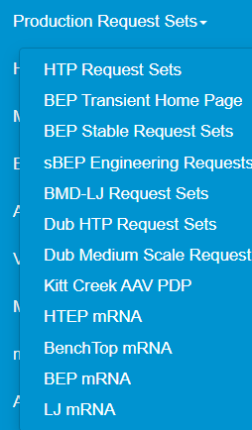
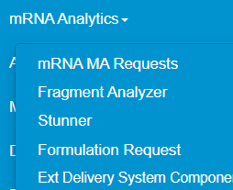
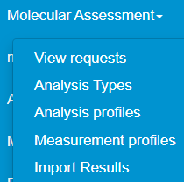

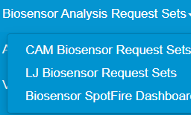
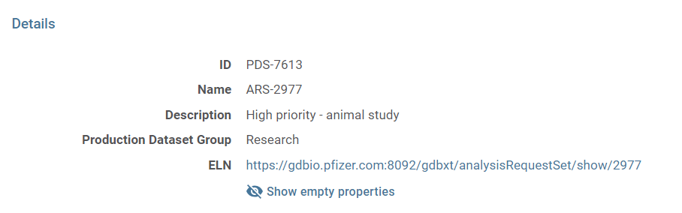


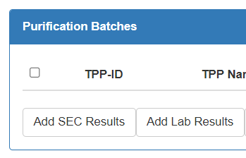
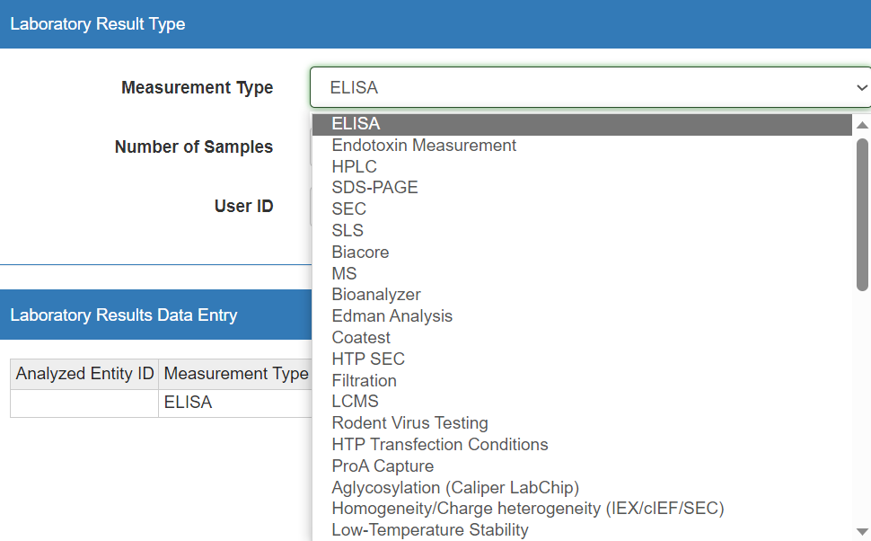

GDBxT Requests and Automatic Genedata Uploading
Production Requests (RS, FRS)
Analysis Requests (ARS)

Slide 14
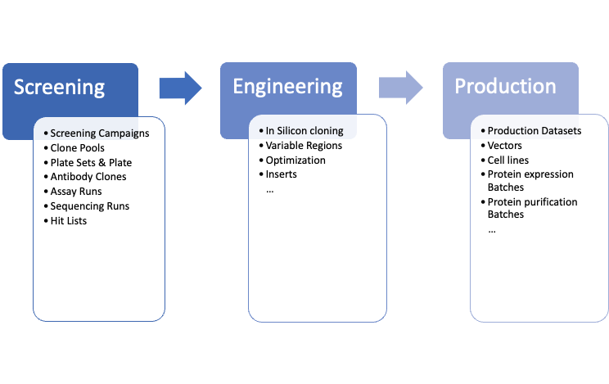
Genedata Biologics major workflow
Antibody Clones
TPPs
Identify lead candidates
Optimize characteristics
Produce target product

Slide 15
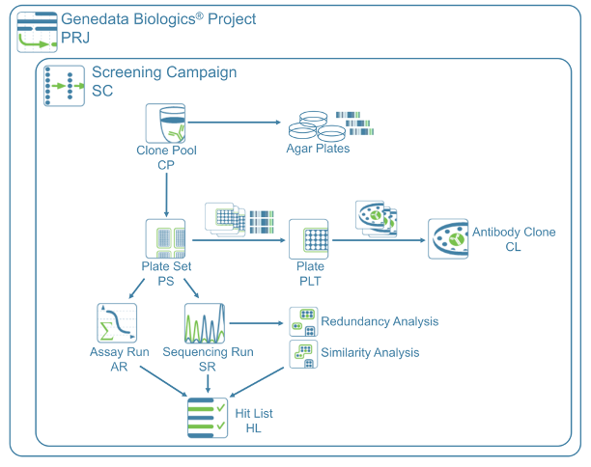
Genedata Biologics Entities in Antibody Screening

Slide 16
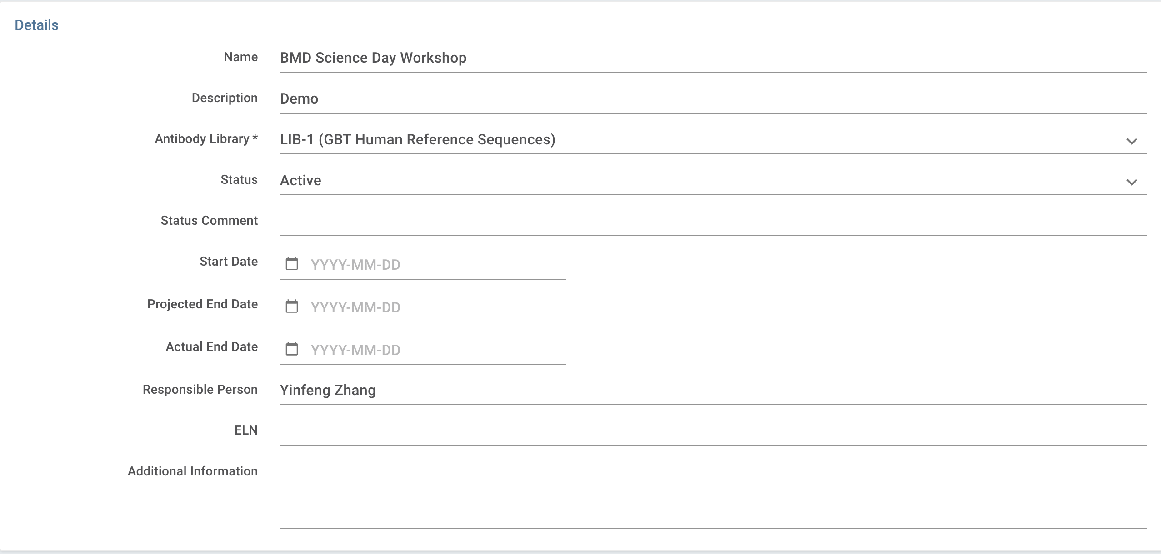
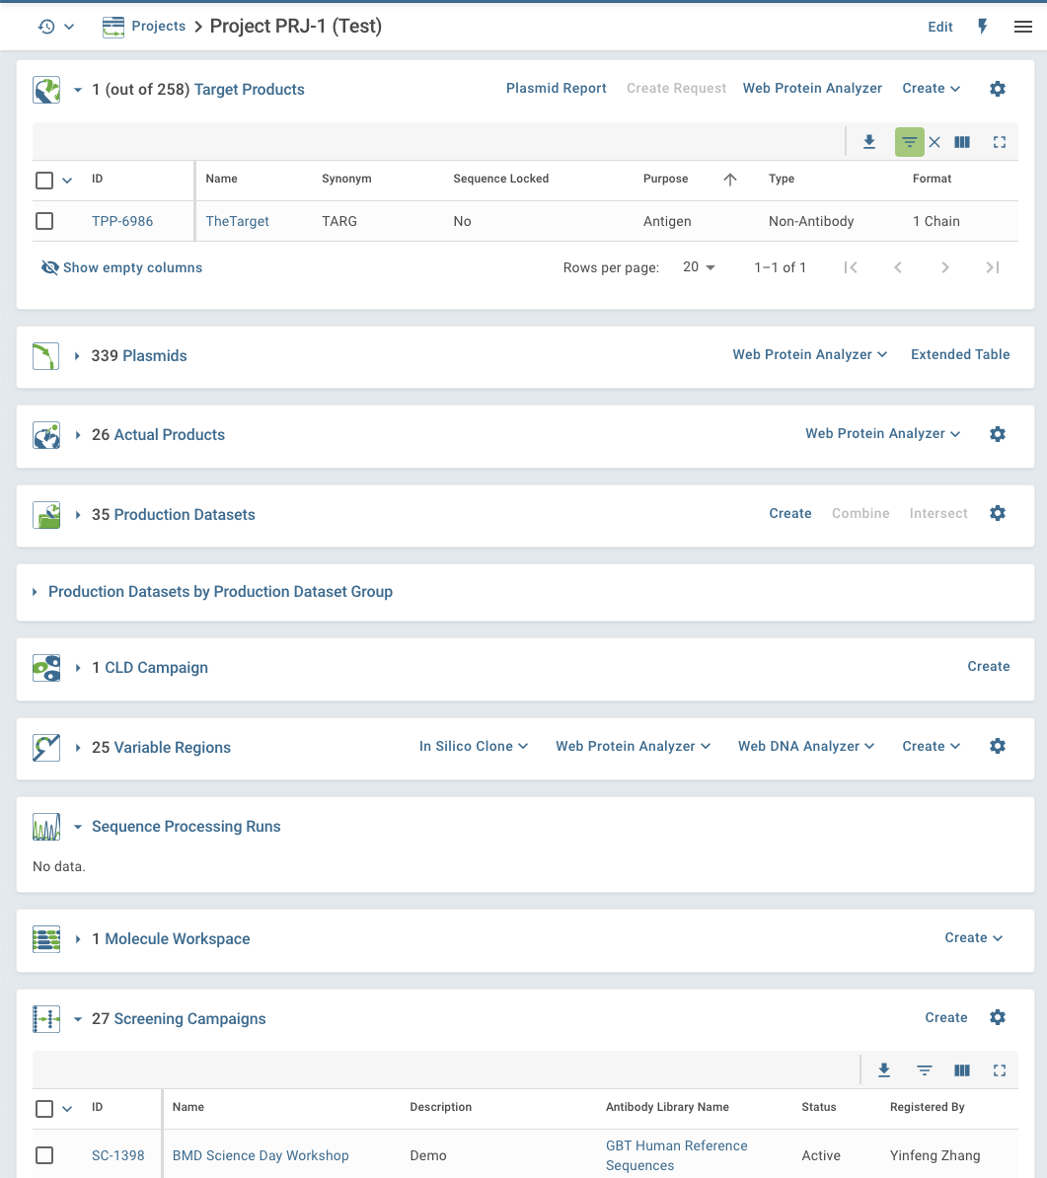


Screening Campaigns (SC)
SC must be associated with an Antibody Library
Antibody Library a set of reference sequence (amino acid) based on the germlines from a species
Income sequences will be compared with the reference sequences for annotation
Separated SCs are needed for different Antibody Libraries/species
Carefully evaluate the number of SCs in a single project

Slide 17



Clone Pool (CP)
The meaning of the clone pools varies for different approaches:
B-cell cloning: each clone pool can represent a set of cells from a donor or animal
Hybridoma: each clone pool can represent a fusion between isolated B cells and immortal myeloma cell
Phage & Yeast display: each clone pool can represent a selection arm, selection round, or selection techniques
Clone Pool Hierarchy
Complicated Phage Display with multiple selection arms

Slide 18





Antibody Clone
Sequences
Assay Result
Sequencing Result
Assay value
Antibody Clone
Chosen
TPP
Level 1
Level 2
Level 3
Level 4
Individual isolates with
global unique ID: CL-XXX
and unique name
re-streak
Child
Antibody Clone
CL-101
VL
CL-301
IgG-LC
Cherry-pick
CL-11
IgG
CL-501
IgG
Transfer among plates
CL-201
VH
CL-401
IgG-HC

Slide 19



Create Antibody Clone
Well specific
(e.g. Conventional phage display/hybridoma)
Plate free
(e.g. Bulk NGS driven phage display)
Phage pool
(sequenced)
Plate Set Creation
(Genedata)
Antibody Clone
Creation
Sequence Importer
(GDBxT)
Default Antibody Clone name:
SC1398-3B10
Customized but unique
Antibody Clone name, e.g. use SC ID as prefix
Screen Campain ID
Plate#
Well#

Slide 20



Hit List (HL)
From Redundancy analysis table
Upload a file with Antibody Clone ID/names
From Assay Results table
Hit List is created to manage selected clones, e.g., the best antibody clones discovered
Clones received from an external source can be registered via hit list
Antibody clone hits can be selected in multiple ways, such as selecting by assay run data, sequence data or uploading a file
Antibody Clones selection
New Hit List
Operations on multiple hit lists

Slide 21




Well-specific Antibody Clone creation

Slide 22






Plate (PLT) and Plate Set (PS)
reformat 4*96 to 1*384 plate
reformat 1*96 to 1*384 plate
A plate set is a group of plates with identical plate formats and layouts
Predefined plate layout

Slide 23




Re-streak Antibody Clones
From Plate Sets
From Hit List
GDBxT
Children antibody clones will be arranged in new plates (plate sets)
Name of Parent Antibody Clone
SC1339-93D04
Default name for children Antibody Clones
SC1339-93D04-1
SC1339-93D04-2

Slide 24






Link Antibody Clones in Genedata with sequencing data
The Key is the Antibody Clone name
Create a plate in Genedata for sequencing purpose
Replacing external Sanger sequencing to Internal Nanopore sequencing

Slide 25





Sequence Import via Sequencing Run (SR)
The sequences from either vendor or in house facility need to be imported into Genedata Biologics and linked with the antibody clones
Each antibody clone may have two chains: VH and VL OR one chain: scFv
VH and VL can be in a same Fasta file or separated into two files: one for VH and one for VL
A series of bioinformatics processing steps will be performed during Sequencing Run creation (Protein type specific)
Limitation: Antibody Clone must exist in Genedata to allow sequence upload
Sequence file

Slide 26




Sequence importer in GDBxT
Fasta file handling
Tool parses fasta headers to extract clone names
Accept zip file as input
Optionally merge multiple fasta files into a single file
Clone name verification or create new clones
Verify if a clone name is already registered in Genedata
Assists in renaming clones
Preview provided before Hit List and/or Sequencing Run creation
Hit List and Sequencing Run creation
After editing clone names, the tool can create a Hit List for new clones and a Sequencing Run
Loading
Editing
Importing

Slide 27






Redundancy Analysis (RA)
Redundancy Analysis can be performed in whole Screen Campaign or a defined Hit List
Each predefined criterion will have a corresponding RA for screening
Sequences from Variable Regions, CDRS and their combinations will be clustered to identify redundant sequences
Representative sequence can be set in each sub-group
Protein sequence aligner
DNA sequence aligner

Slide 28


Assay Run
Assay run contains a set of assay values measured during an experiment
The experiment and its attributes are configured in the Measurement Type
Similar to Laboratory Results but for each Antibody Clone
Values used for identify hits and decision make

Slide 29






Upload result to Assay Run
Machine readout

Slide 30




Variable Regions (VRs)
VH-VL pairs are highly encouraged to be registered in Genedata as VRs
VL and VH from one VR will form 2 inserts to enable flexible in-silicon cloning, especially for bispecific antibody creation
TPPs carrying the same VR will be grouped together
VR is easy to be created with multiple methods:
From a single or multiple antibody clones
From Hit List
From FASTA amino acid file
From a GeneBank file
From existing variable regions

Slide 31





In-silicon cloning
LVEC
Antibody Clone
Crucial to select the correct LVEC

Slide 32




In-silicon cloning: inside Genedata
Through Hit List
Through Variable Region

Slide 33






In-silicon cloning: Create Mix and Match TPPs
Newly created TPP
Move to GDBxT
Newly created Vector
Register into Genedata
Upload Paring File (save as .csv format)
Hit List

Slide 34
Acknowledgements
Pfizer | Genedata
Joel Bard | Yi-Wei Lee
Lijian Yu | Guido Cappuccilli
Tatyana Zamkovaya | Sebastian Schlicker
Fabian Sievers | Amanda Fitzgerald
David Palmer | Jessy Sheng
Yuan Lin
Jessica Min-Debartolo
Weixu Meng

Slide 35
Questions?

Slide 36
Take-home Message
Genedata Biologics and its companion, GDBxT, are power tools in the discovery of novel therapeutical antibody and other molecular (RNA, AAV)
Genedata Biologics is a centralized data presentation platform to share data and make decisions
Genedata can be customized to work with different processes
Contact DL-BMD_BIOINFORMATICS if you have questions or would like to discuss how Genedata can help you

Slide 37
Backup

Slide 38

Alternative phage display screening methods
Well specific
Plate free
Genedata Biologics can be customized to suit various screening methods

Slide 39




PPB Cont.

